Slide 1


Association for Financial Markets in Europe
Brexit: Latest developments and what next?
23 October 2017
Simon Lewis, Chief Executive, AFME
Robert van Geffen, Director, Policy, AFME
Nicolas Véron, Senior Fellow, Bruegel

Slide 2
Association for Financial Markets in Europe
Introduction
Simon Lewis, Chief Executive, AFME

Slide 3
Association for Financial Markets in Europe
AFME’s work on Brexit
Robert van Geffen, Director, Policy, AFME

Slide 4
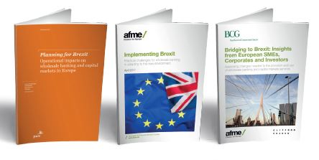
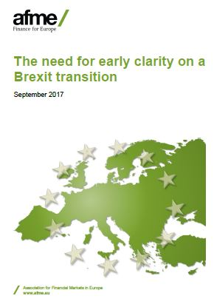
Brexit - AFME work programme
Fact-based, pan-European approach led by AFME Board-level steering group.
Aim to act as a bridge for conveying market expertise and insight to policymakers and regulators
A series of AFME publications throughout 2017
Publications have analysed the potential impact and practical challenges of Brexit, on wholesale banking through to the real economy.
Recent publications highlighting the need for transition and continuity of contracts.

Slide 5
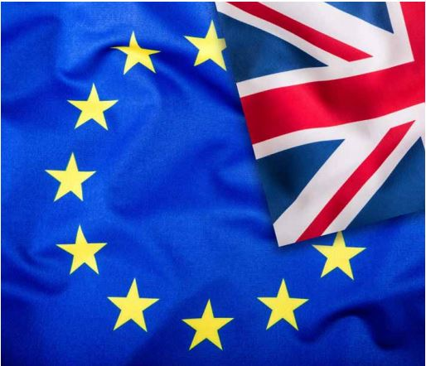
Brexit - AFME work programme
Ongoing work:
Comprehensive outreach programme with policymakers in DE, FR, NL, UK, IT, SW, and EU presidencies
Evaluating member priorities for further work e.g. repapering, CCP recognition and implications of Withdrawal Bill
Will continue to make the case for the importance of clarity for industry, regulatory flexibility and for transition arrangements to be agreed as soon as possible.

Slide 6
Brexit:
UK vs EU27 Perspectives
Nicolas Véron
Senior Fellow, Peterson Institute for International Economics (Washington DC) and Bruegel (Brussels)
AFME Members’ Briefing Call
October 23, 2017

Slide 7
Mindset
UK: maximisation of gain
  “best possible Brexit”, win-win or win-lose deal
EU27: preservation / damage limitation
  Brexit is a lose-lose proposition in all scenarios
Credit investors vs equity investors

Slide 8
Structure
UK: symmetrical
  UK vs EU
EU27: asymmetrical
  UK is a member state
e.g. Court of Justice

Slide 9
Rules of the Game
UK: once and for all
EU27: repeat game
Outcomes vs incentives

Slide 10
Game Theory
UK: no sensible alternative to Art50 deal
EU: “no deal is better than a bad deal”
“Madman” negotiating strategy is inherently low-trust

Slide 11
Politics
UK: domestic politics
  Even if not along party lines
  Questions in Westminster every week
  Constant media attention
EU27: international diplomacy
  Differences among member states are about interests not principles
  Shared interest of all on the financial issue
  Not a domestic political issue in any member state?

Slide 12
Information
UK: self-centered
EU27: UK-focused
UK-based international press is EU27 press by default
  UK bias varies across papers, partly filtered out
  (Almost) no EU27-wide alternative coverage

Slide 13
Thank You For Your Attention
Nicolas Véron
nicolas.veron@gmail.com
+32 473 815 372 / +1 202 550 0614
Twitter @nicolas_veron

Slide 14
Any questions?
?
?
?

Slide 15
Offices
  The Association for Financial Markets in Europe advocates stable, competitive and sustainable European financial markets that support economic growth and benefit society.
London Brussels Frankfurt
39th Floor Rue de la Loi 82 Skyper Villa
25 Canada Square 1040 Brussels Taunusanlage 1
London, E14 5LQ Belgium 60329 Frankfurt am Mai
United Kingdom Germany
Tel: +44 (0)20 3828 2700 Tel: +32 (0)2 788 3971 Tel: +49 (0)69 5050 60 590
www.afme.eu

